Slide 1

























FIFA WOMEN'S WORLD CUP 2023
AUSTRALIA & NEW ZEALAND
Juan Restrepo, Javier Bermúdez, José Silva, Isabella Ceballos and Valeria Cruz

Slide 2



Slide 3
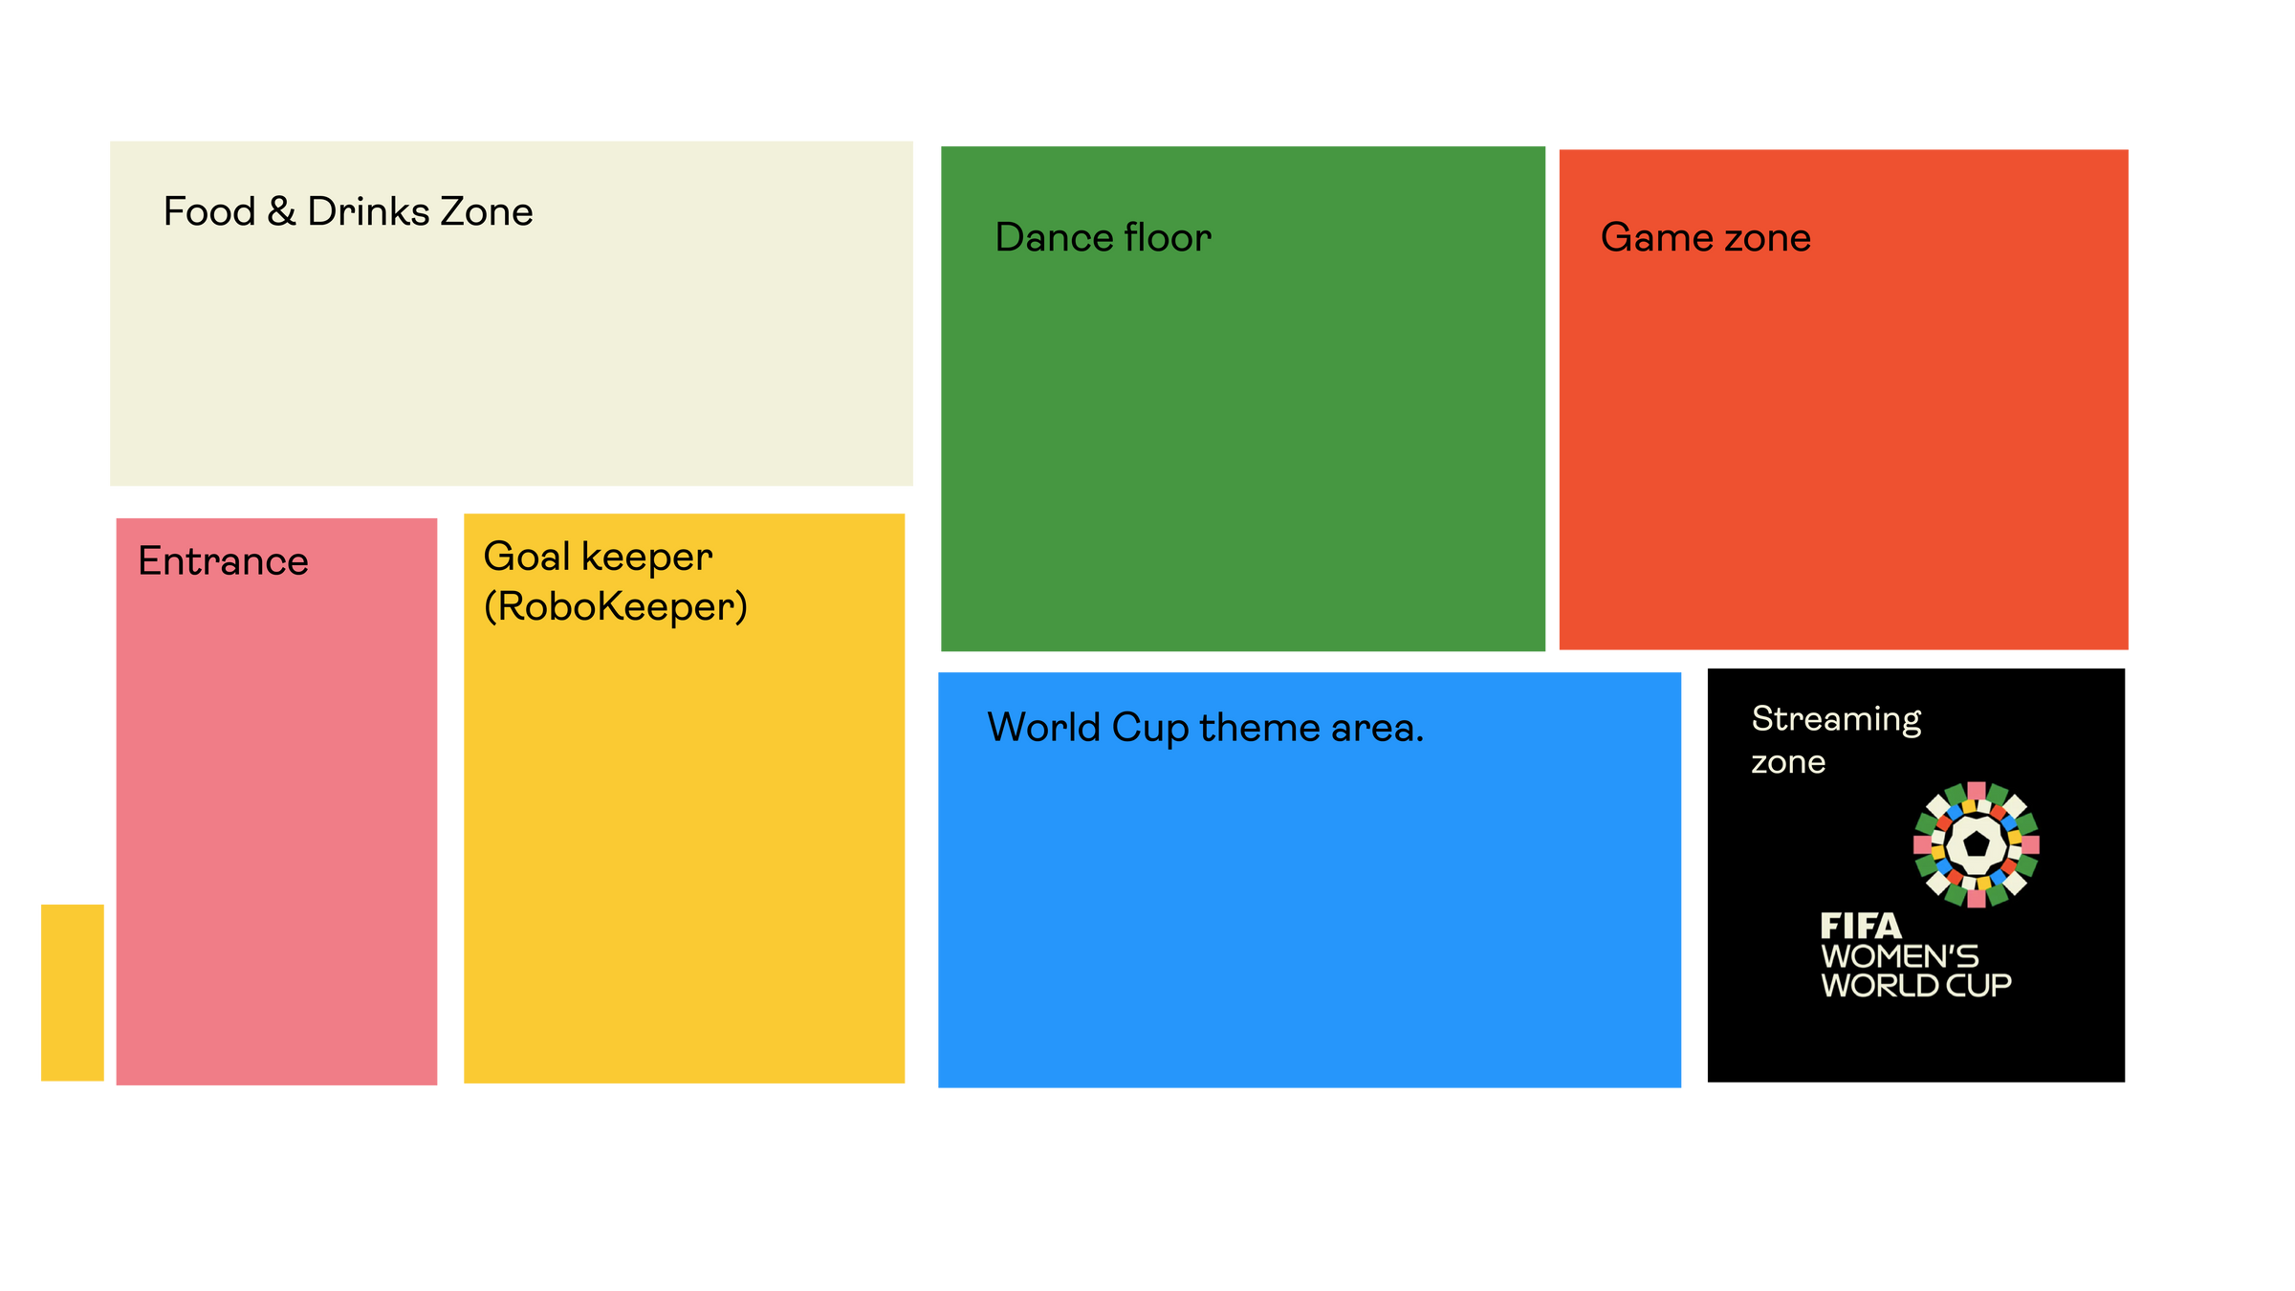
Football Party

Slide 4
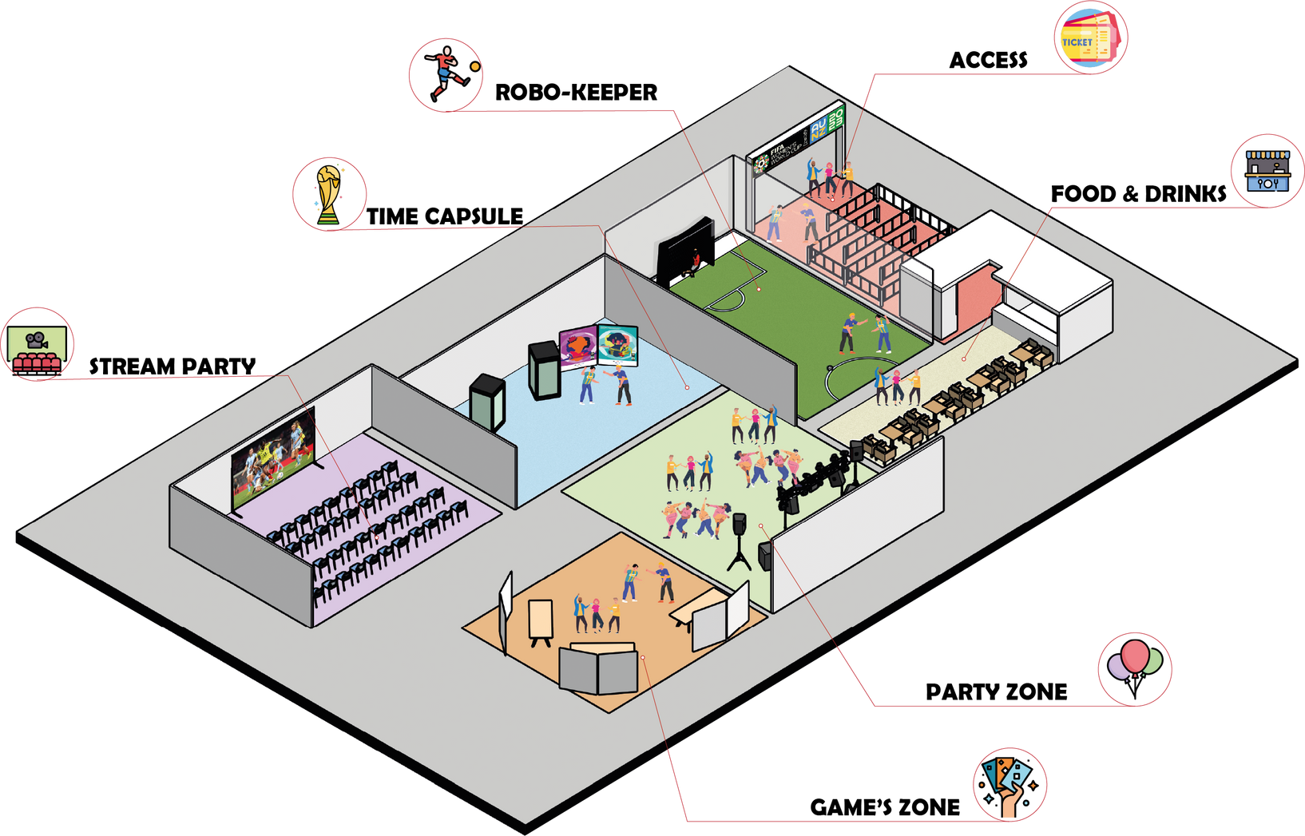
Football Party

Slide 5
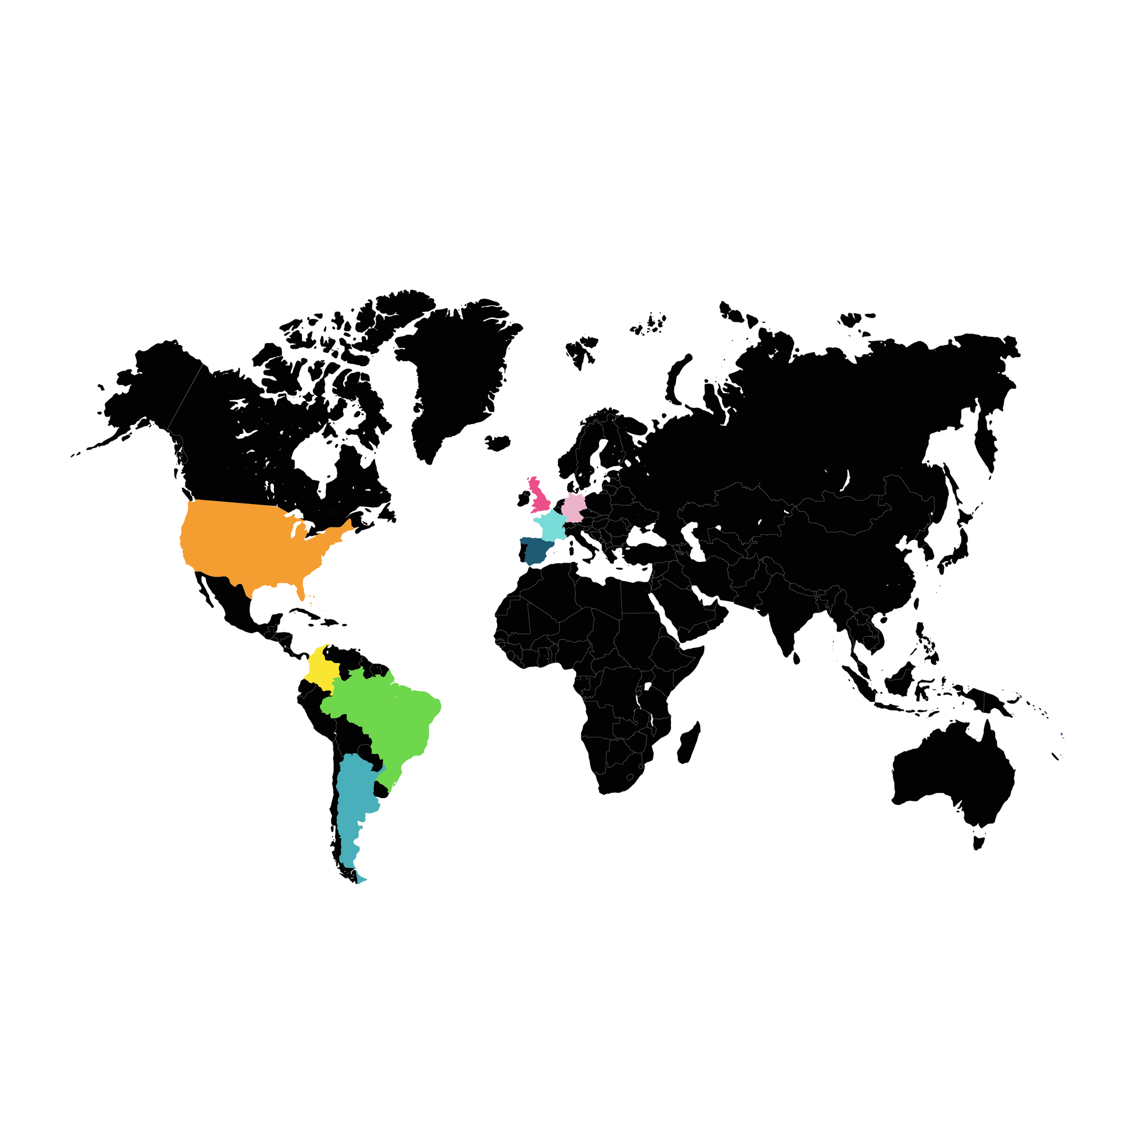
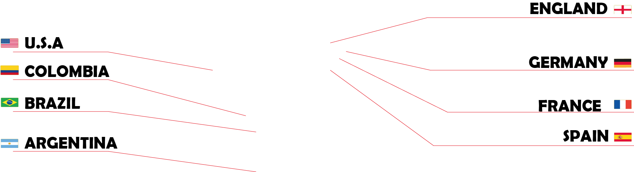
Participating Countries

Slide 6


Slide 7

KIT

Slide 8

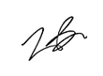
Collectible cards

Slide 9
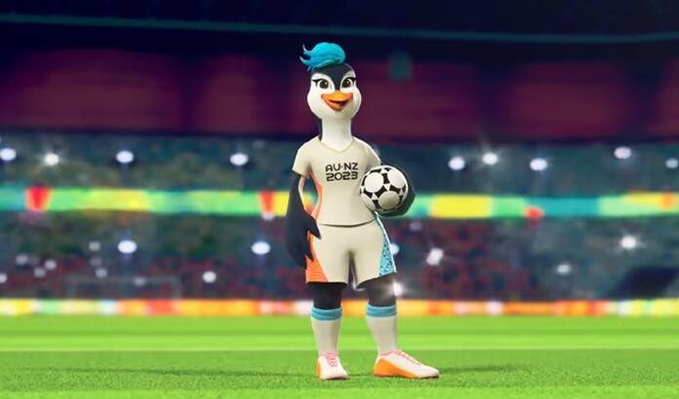
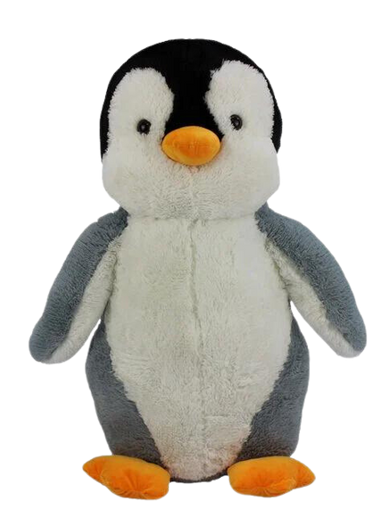

Stuffed toy
The kit will also include a penguin stuffed toy due to the official mascot of the competition (TAZUNI)

Slide 10


Exclusive T-shirt

Slide 11
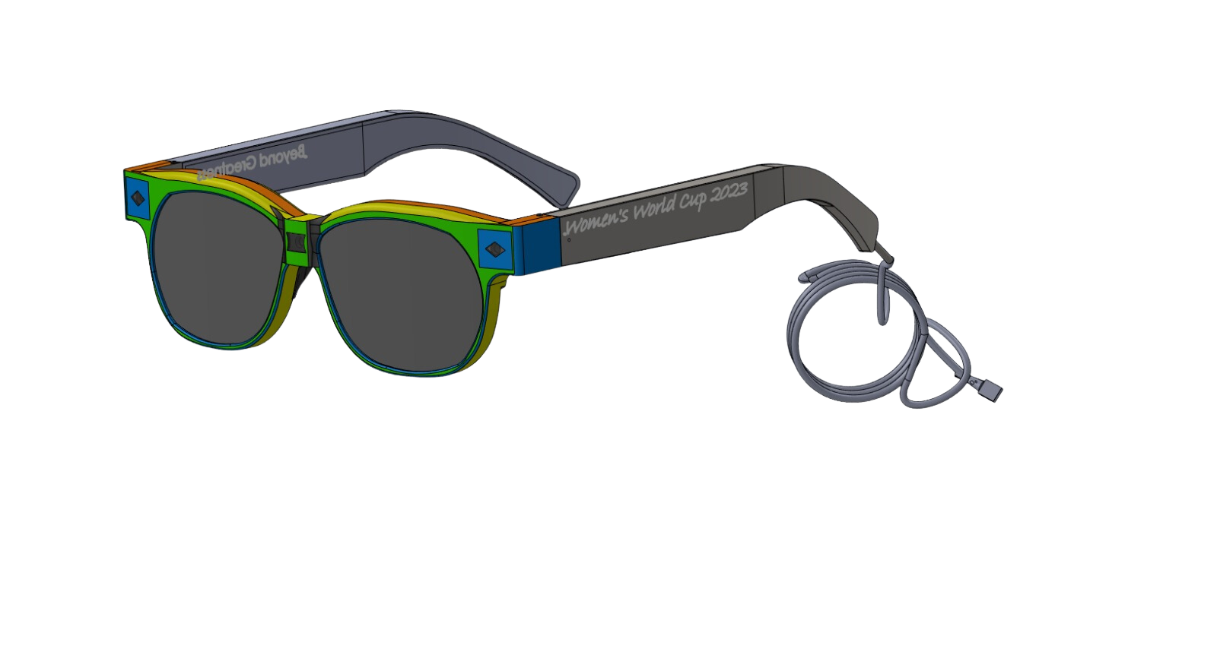
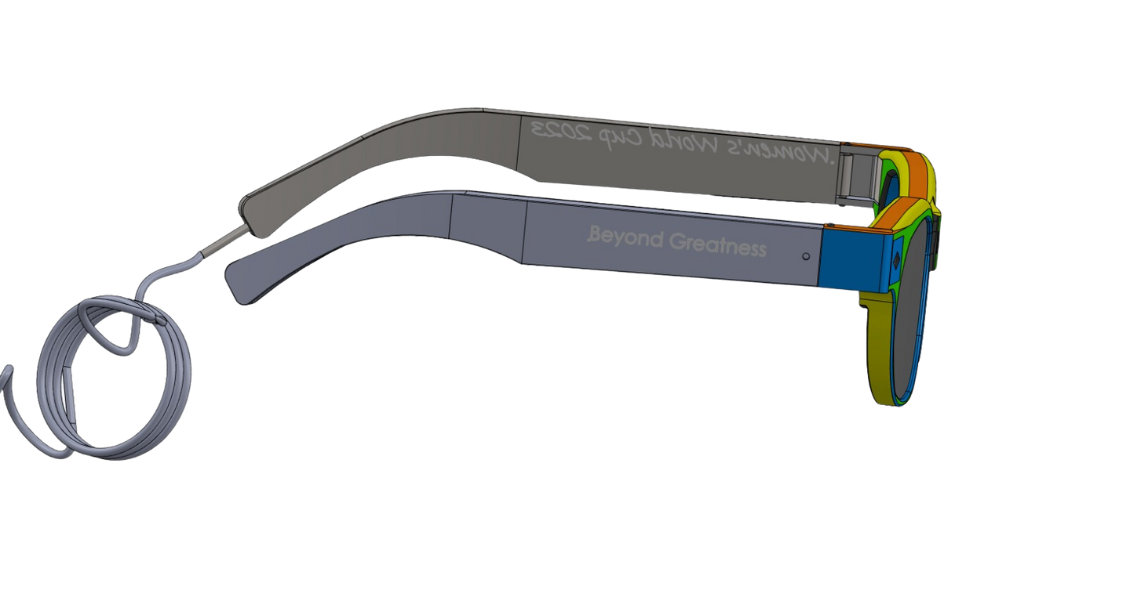
VR Glasses
The kit will allow you to immerse yourself in a virtual experience and feel like you are with the other fans in the stadium

Slide 12
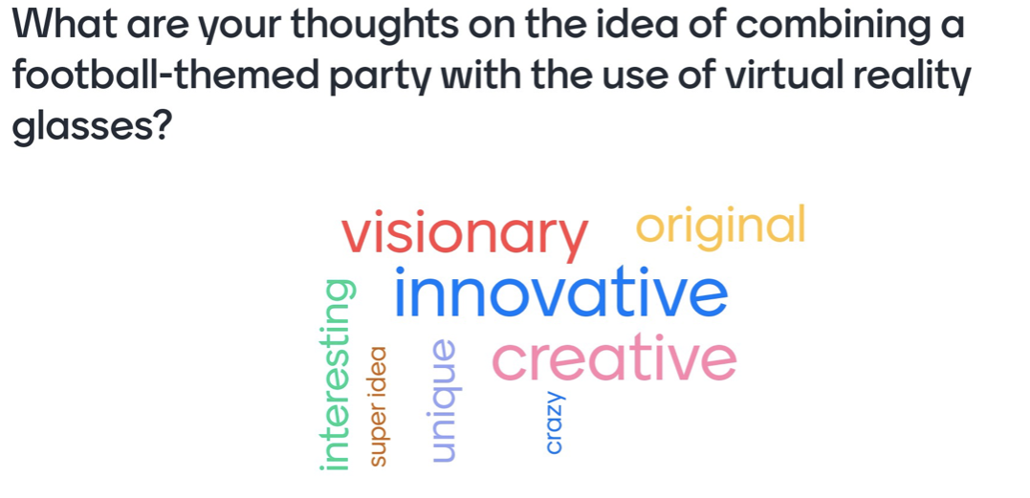
User Surveys

Slide 13
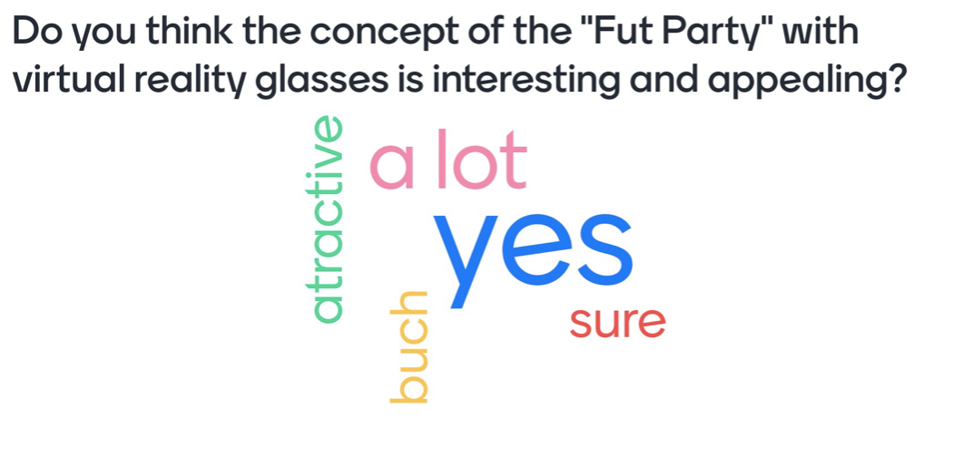
User Surveys

Slide 14
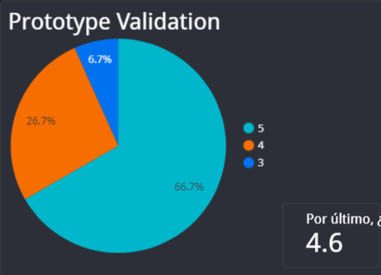
User Surveys
We conducted surveys with different users to find out their opinion about our proposal. (1 the lowest and 5 the highest)
At the end we got an average rating of 4.6
Average score

Slide 15



Verbatims
"I find the glasses and the kit in general exciting"
"I like the way of watching the matches in augmented reality"
"I love the activities before the dance floor."

Slide 16

Exclusive discount coupons
For those who attend to the "Football Party", there will be exclusive coupons to watch the matches of the Lionesses in the WORLD CUP.

Slide 17

THANKS!

Slide 18




In collaboration with

